Slide 1
Physics-informed neural networks for solving of unsaturated groundwater flow
Ivan Đepina¹, Hrvoje Gotovac*²
¹Department of Civil and Environmental Engineering, Norwegian University of
Science and Technology, Trondheim, Norway
²Faculty of Civil Engineering, Acrhitecture and Geodesy, University of Split, Croatia.
* Presenting Author
February 20, 2025, DTE&AICOMAS 2025, Paris, France.

Slide 2
Content
Introduction
Problem formulation and methodology
- Richards equation
- PINN
- Results
Conclusions and Future Directions

Slide 3
Introduction
Groundwater resources are the base water resources on the Earth
Unsaturated groundwater flow is vital for water, solute and energy transport from the surface to the water table
Broad application, among others, in soil mechanics, agriculture, water management, hydrogeology and reservoir engineering
Usually unsaturated groundwater flow is presented by Richards equation (1931)
Usually Van Genunchten soil parameters are used which present nonlinear relationship between water content, relative permeability and pressure head
Unfortunately, it is strongly nonlinear differential equation, quite challenging for classical numerical methods such as FDM, FV, FEM, IGA and others
How Physics-informed neural networks (PINN) is suitable for this task?

Slide 4
Richards equation
Van Genunchten parameters???

Slide 5
Different form of Richards equation in the collocation strong formulation
Pressure head formulation Volumetric water formulation
Water storage function
Van Genunchten parameters

Slide 6
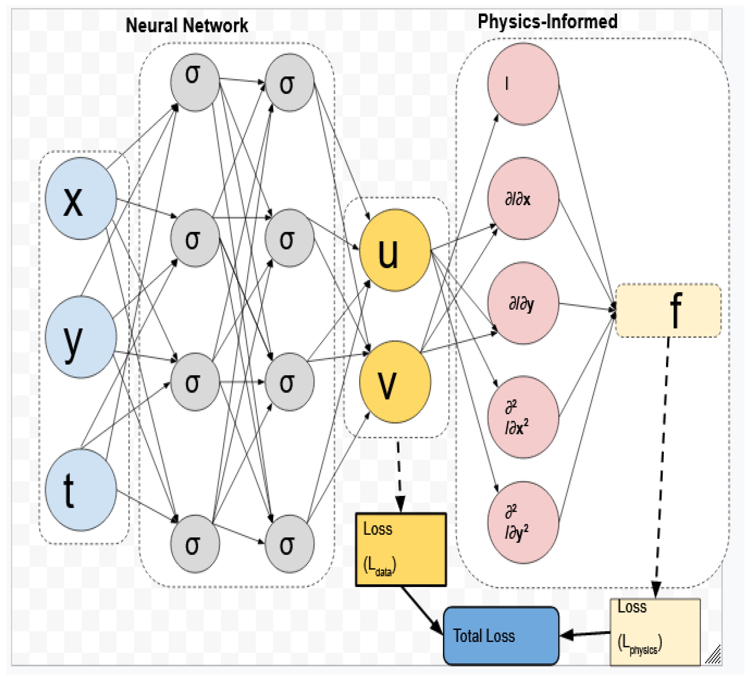
PINN inverse scheme

Slide 7
PINN – technical details (Đepina et al., 2022, Georisk)
Classical collocation based loss function
Automatic differentiation (AD)
Multi-Layer Perceptron (MLP)

Slide 8
PINN – Solving procedure (Đepina et al., 2022, Georisk)
Inner loop
Loss function is minimized for a given value of VG parameters
The inner loop was implemented with the L-BFGS-B optimisation algorithm (Zhu et al., 1997) that is available in TensorFlow
Outer loop
The outer loop is implemented with the global optimisation Cross Entropy (CE) algorithm (Botev et al., 2013)
The CE algorithm with normal updating is implemented in this study. In the CE algorithm with normal updating, an independent normal random search distribution is assigned to each of the variables in λ

Slide 9
Results - Inverse problem solution for the pressure head PINN formulation

Slide 10
Results - Inverse problem solution for the volumetric water PINN formulation

Slide 11
Results - Water infiltration column setup with the PINN prediction of the solution and comparisons with the measurements

Slide 12
Conclusions and Future Directions
PINN solves the inverse problem of unsaturated groundwater flow
Loss function is sequentially solved in inner loop for network parameters and in outer loop for VG unsaturated parameters
Results are shown for pressure and volumetric water formulation
Ongoing research tends to apply PINN to the application of inverse 3-D karst flow and transport modelling
Uncertainty quantification of heterogeneity distribution, unsaturated parameters or conduit configuration will be analyzed by Bayesian PINN approach

Slide 13

Aknowledgements
This research was funded by the Croatian Science Foundation (in Croatian: Hrvatska zaklada za znanost - HRZZ) through the scientific project "Multiphysics modelling of surface-subsurface water systems", grant number: IP-2020-02-2298.

